Slide 1
Normalization of T21 Samples in DESeq2
By: Samuel Hunter

Slide 2
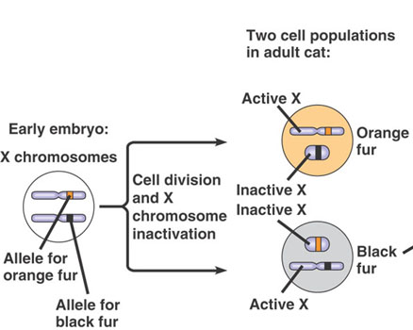

Canonical dosage compensation: X inactivation in female mammals
https://socratic.org/biology/genetics-inheritance/x-inactivation
Notes:
Good slide illustrating the confusion

Slide 3
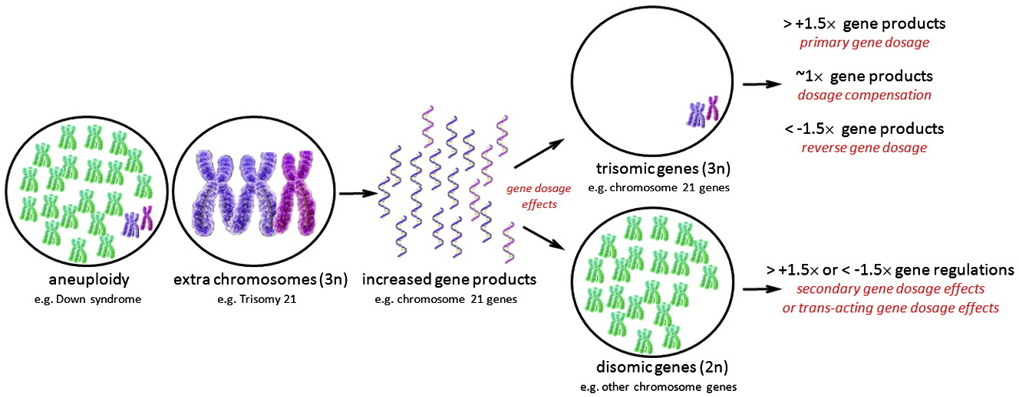
“Dosage compensation” in Down syndrome? Are there any genes which exhibit compensation?
Wang 2011
Notes:
Good slide again, perhaps redundant

Slide 4
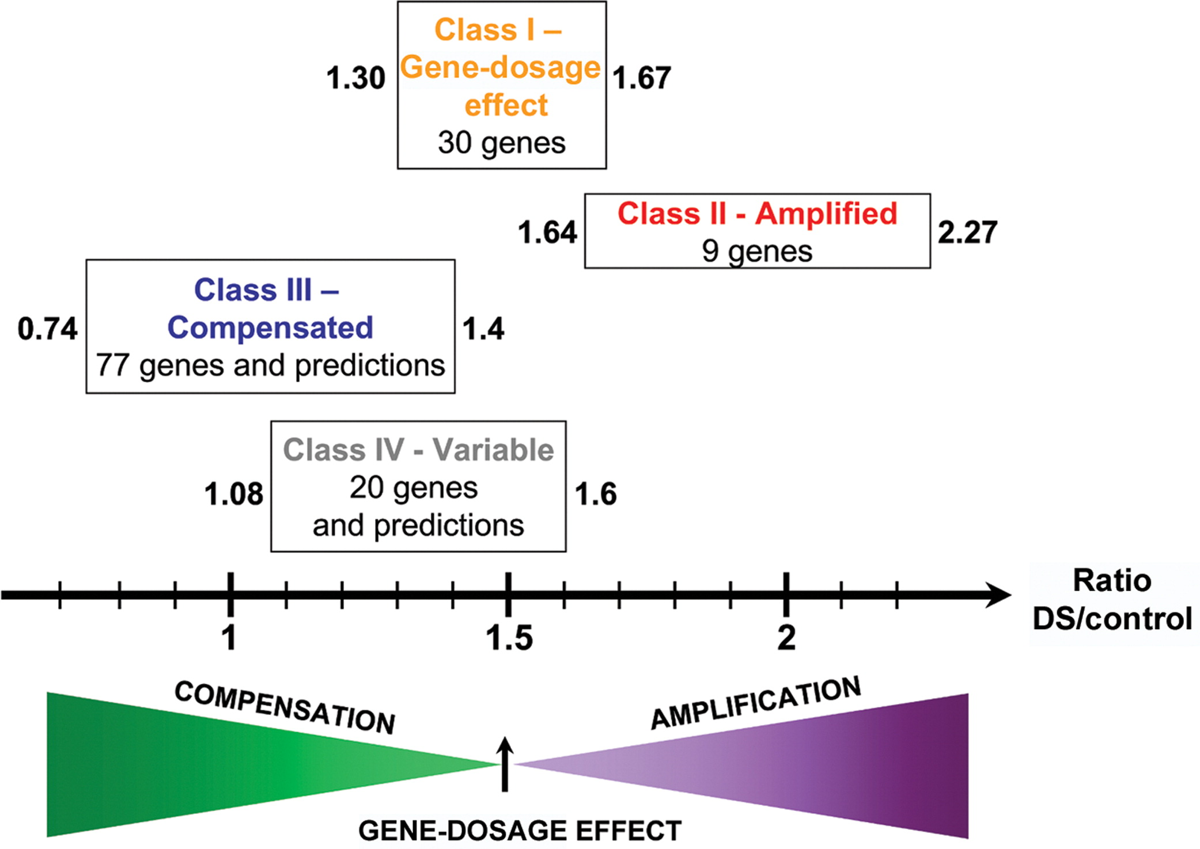
There is some conflict in the literature about whether dosage compensation occurs in trisomy 21
Yahya-Grayson et al, 2007
Notes:
Good summary slide illustrating the problem

Slide 5


If any compensation were occurring, then the distribution of fold changes on chr21 should shift accordingly
1.5x
Some Chr21
are compensated
No Dosage
Compensation
Fold Change
1.0x
Non-chromosome 21 Genes
Chromosome 21 Genes

Slide 6
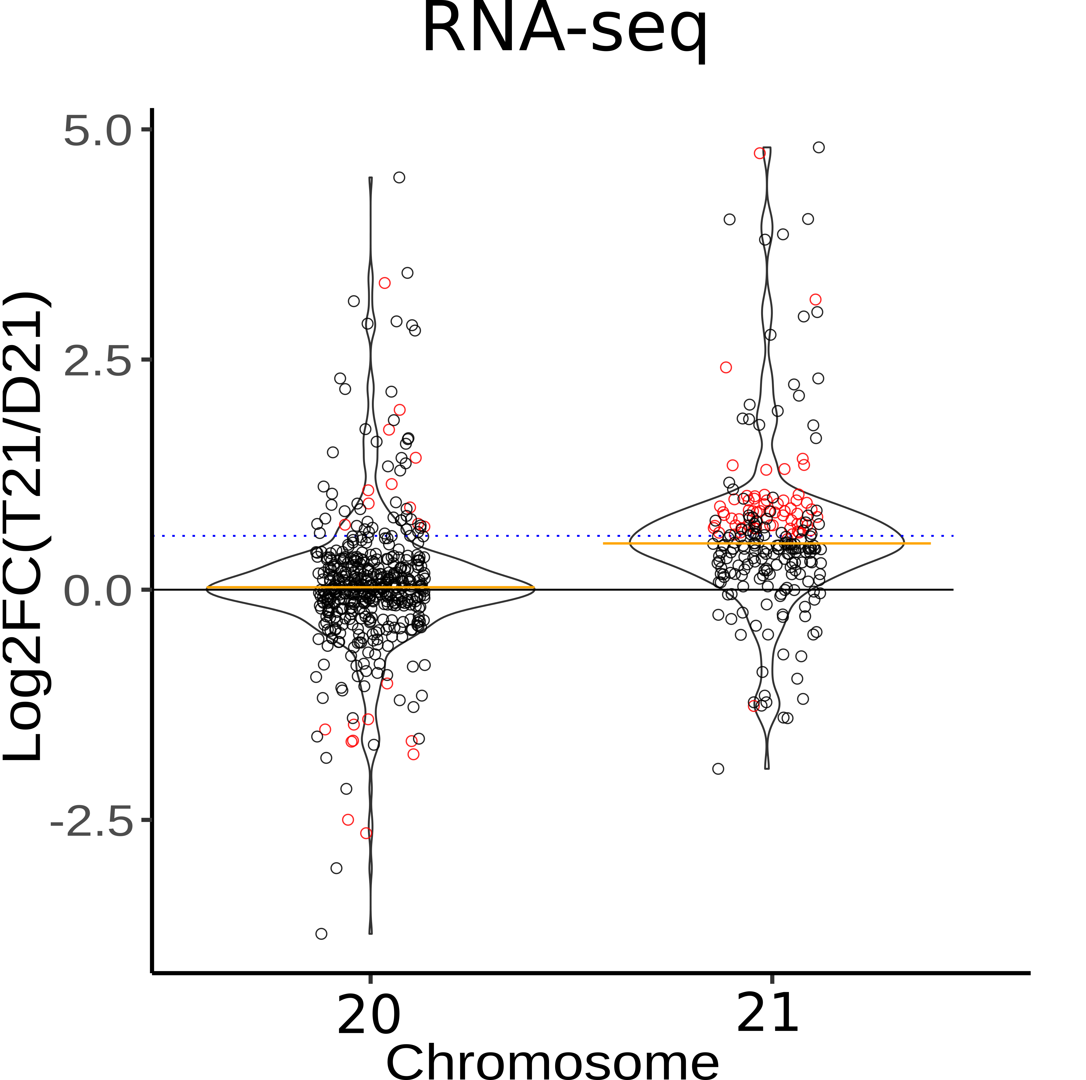
Naïve analysis: fold change are slightly below expectation. Some chr21 genes fall below a LFC of 0!
Notes:
Basically just show the before/after for GRO-seq next to the pipeline. Say you did a bunch of things, and found only a handful of DC genes

Slide 7
Exercise

Slide 8
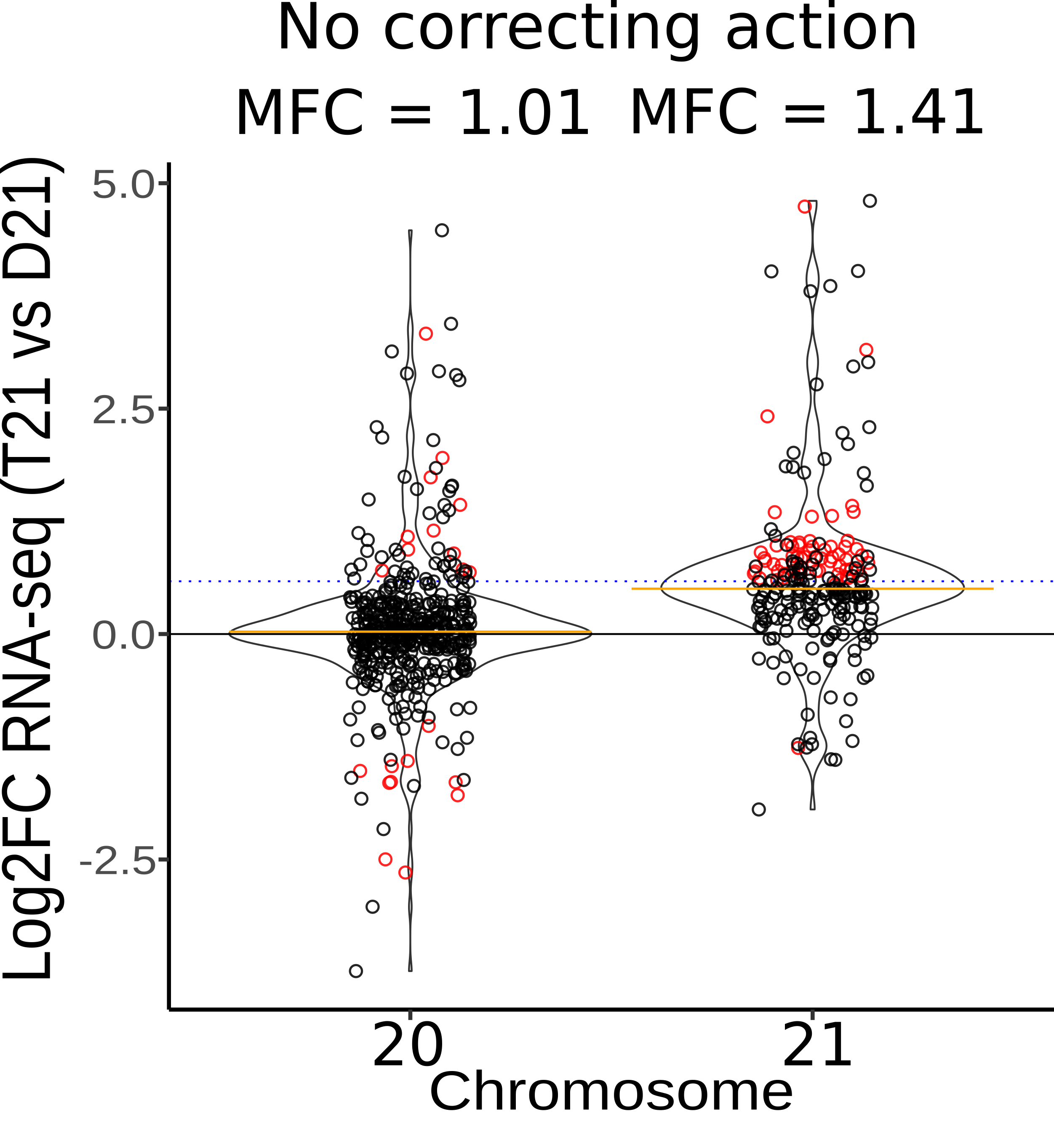
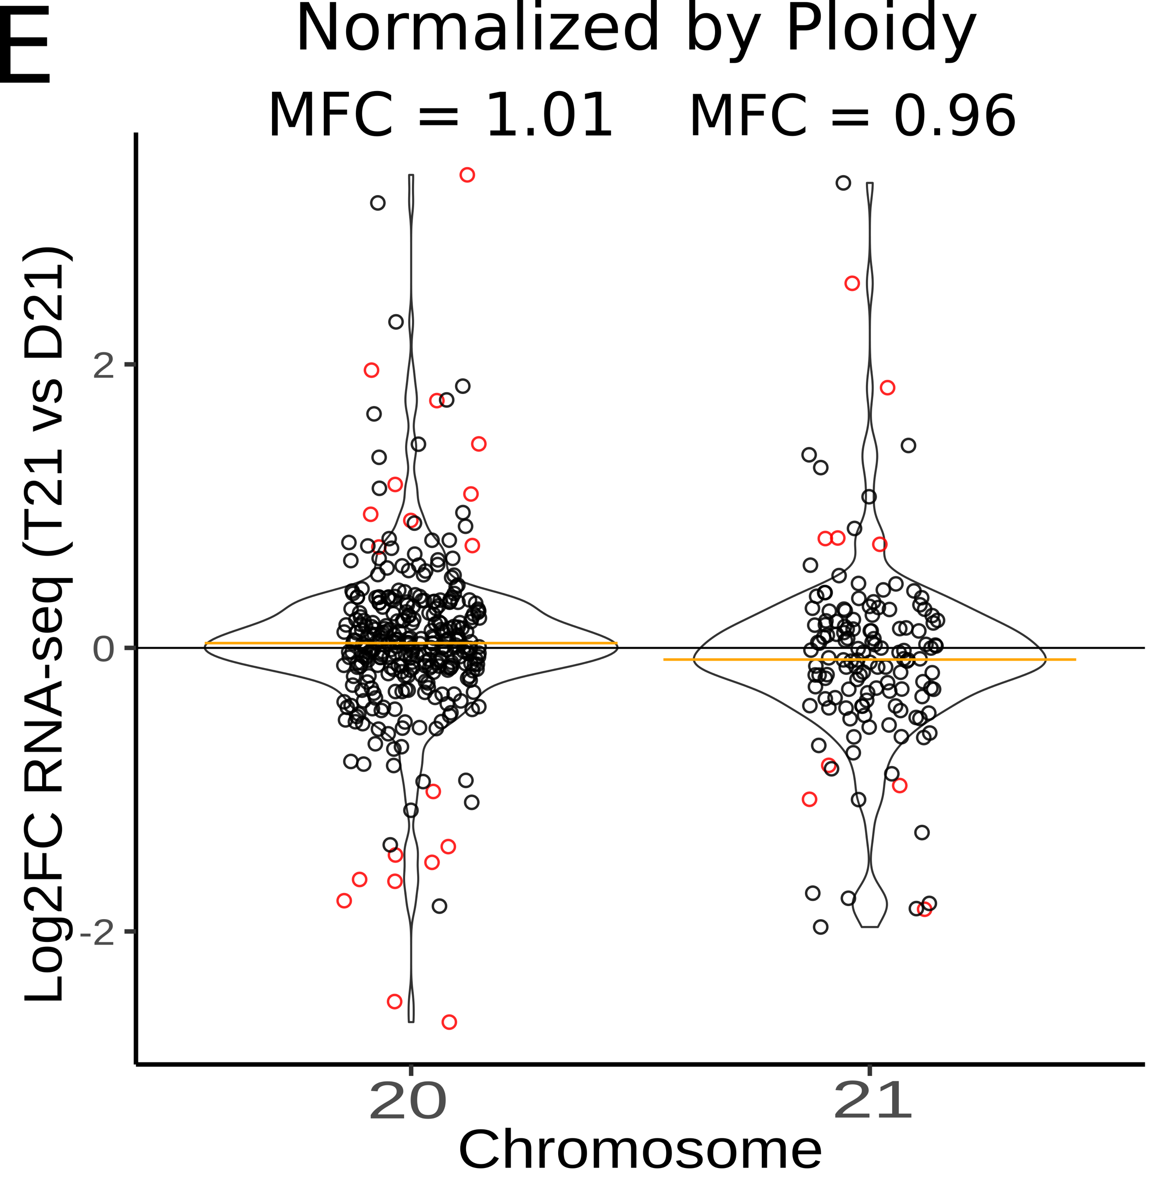
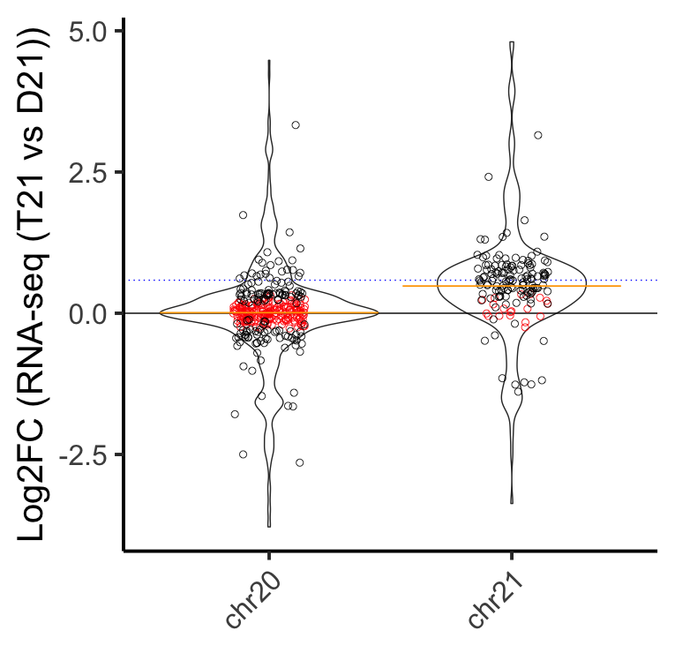
Reframing the Hypothesis:
Divide Reads By Ploidy
H0: FC = 1.0
HA: FC =/= 1.0
H0: FC = 1.0
HA: FC =/= 1.0
H0: abs(LFC) >= log2(1.5)
HA: abs(LFC) < log2(1.5)
Significant genes are those which are different than D21 expression levels
Significant genes are those whose average expression per copy is different
Significant genes are those which are expressed below expectation (1.5)

Slide 9
